Slide 1
Rainfall Data Analysis Overview
Indian Government Dataset Analysis
Insights and Observations from NRSC Rainfall Dataset

Slide 2
Overview of Dataset
- The dataset contains rainfall data for different states and districts.
- Key columns include State, District, Date, and Avg_rainfall.
- Analysis focuses on top rainfall states, districts, and trends over time.

Slide 3
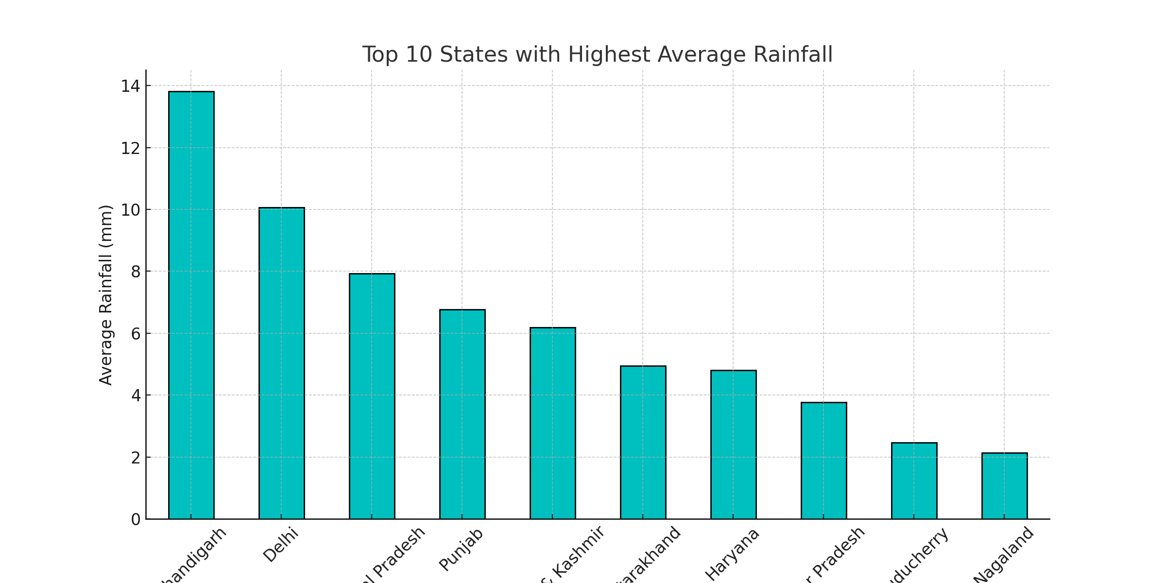
Top 10 States with Highest Rainfall
Observation:
- Some states receive significantly higher rainfall than others.
- Helps in identifying regions prone to heavy rainfall for better planning.

Slide 4
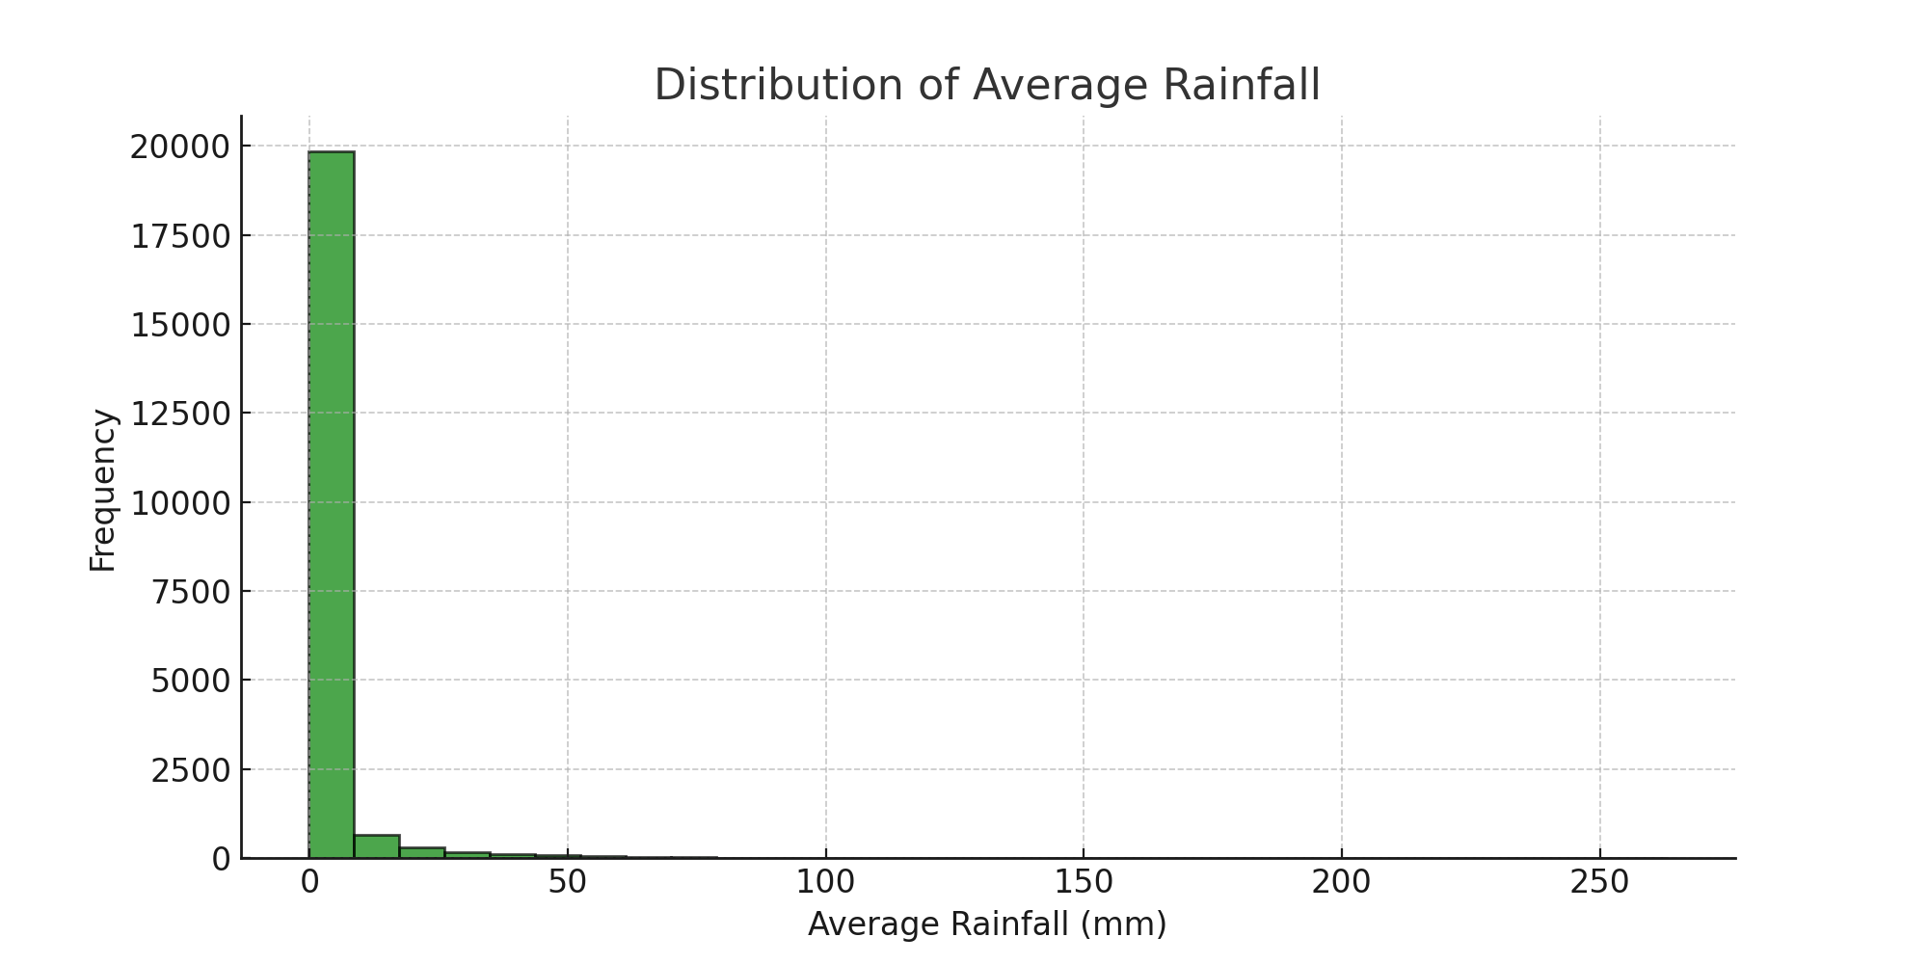
Distribution of Average Rainfall
Observation:
- Rainfall data follows a skewed distribution.
- Most areas receive low to moderate rainfall, but some experience extreme values.

Slide 5
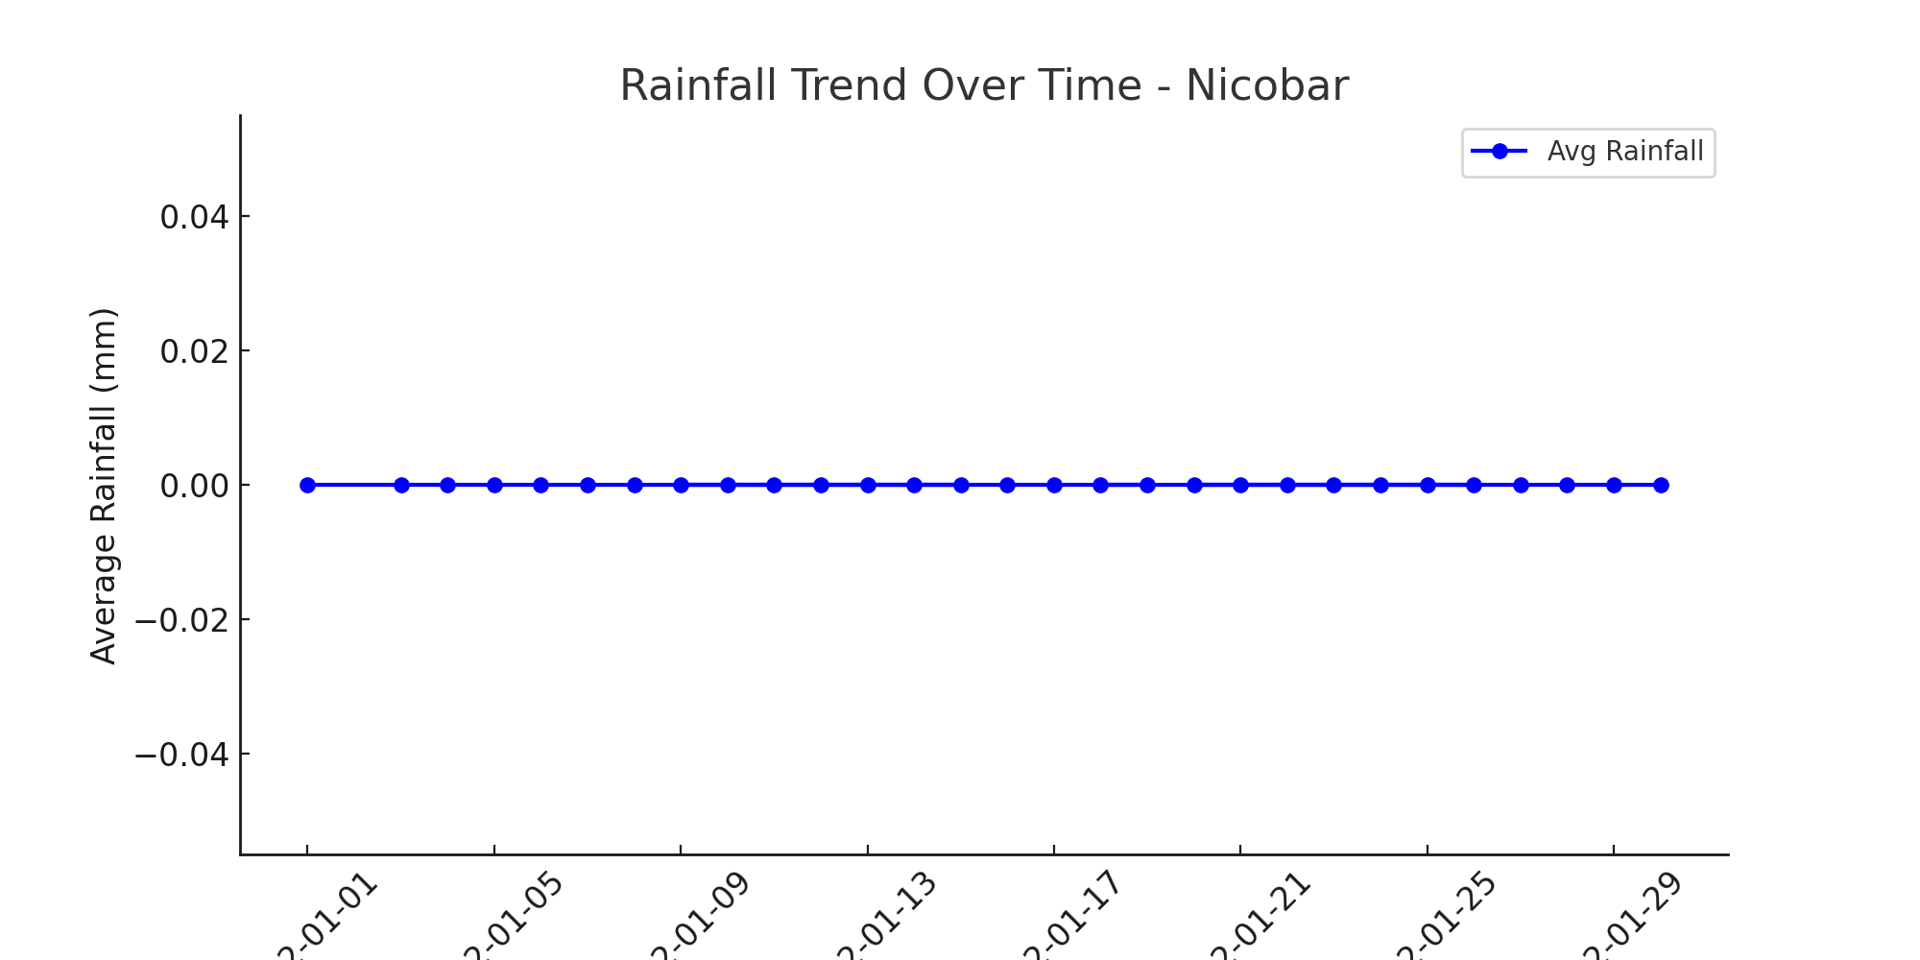
Rainfall Trend Over Time - Nicobar
Observation:
- Nicobar experiences fluctuating rainfall trends.
- Peaks indicate heavy rainfall periods, while dry spells are also visible.

Slide 6
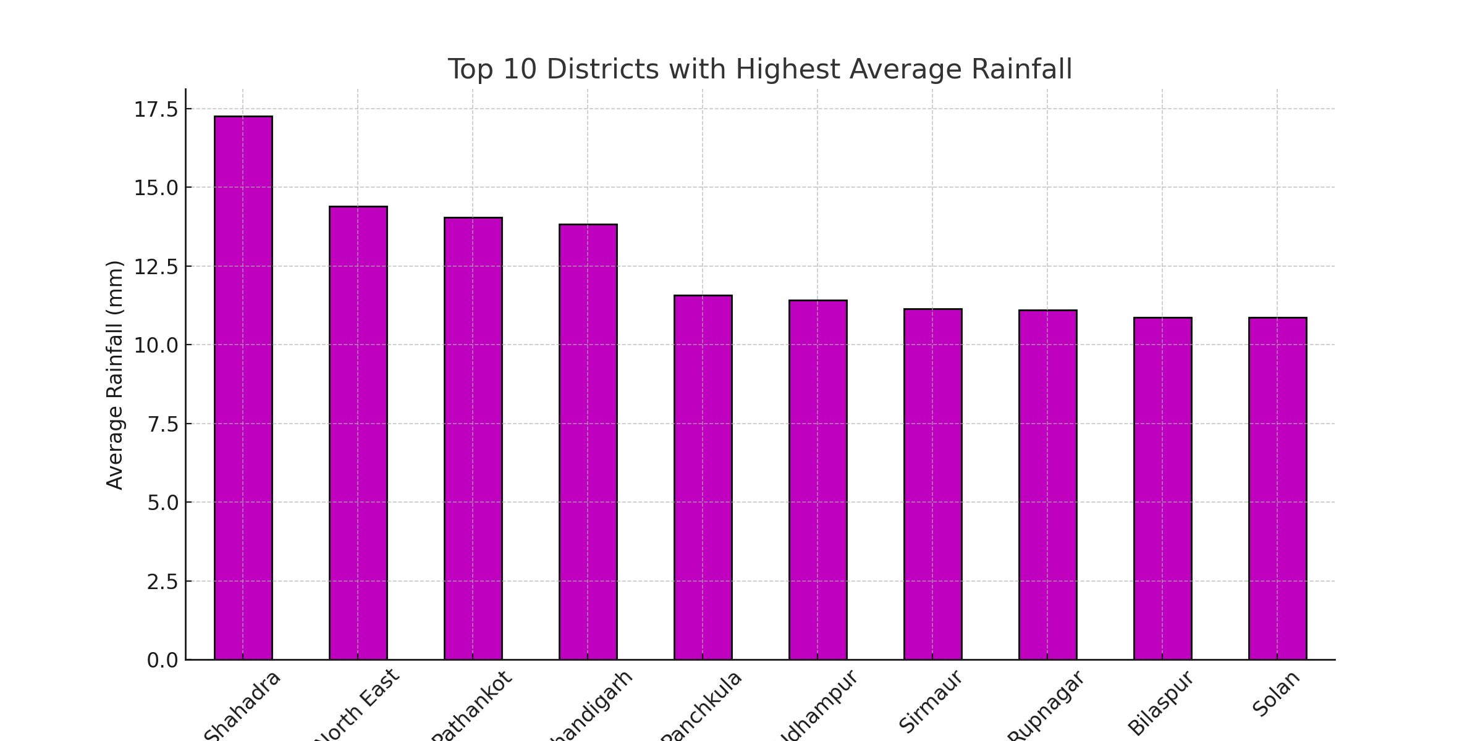
Top 10 Districts with Highest Rainfall
Observation:
- Some districts receive significantly more rainfall than others.
- Useful for resource allocation, agriculture, and infrastructure planning.

Slide 7
Conclusion
- The highest average rainfall is observed in specific states and districts.
- Rainfall distribution shows significant variation across regions.
- Trends over time highlight fluctuations in rainfall patterns.
- Insights can be used for weather forecasting and policy planning.

